Slide 1
Group Nitro
CSE-310 IoT Final Project Presentation

Slide 2
Group Members
Kenan Ufuk İncik - 20180808017
Bengisu Şahin - 20180808052
Hasan Berk Saygu - 20190808007
Özgür Baltacı - 20180808066

Slide 3
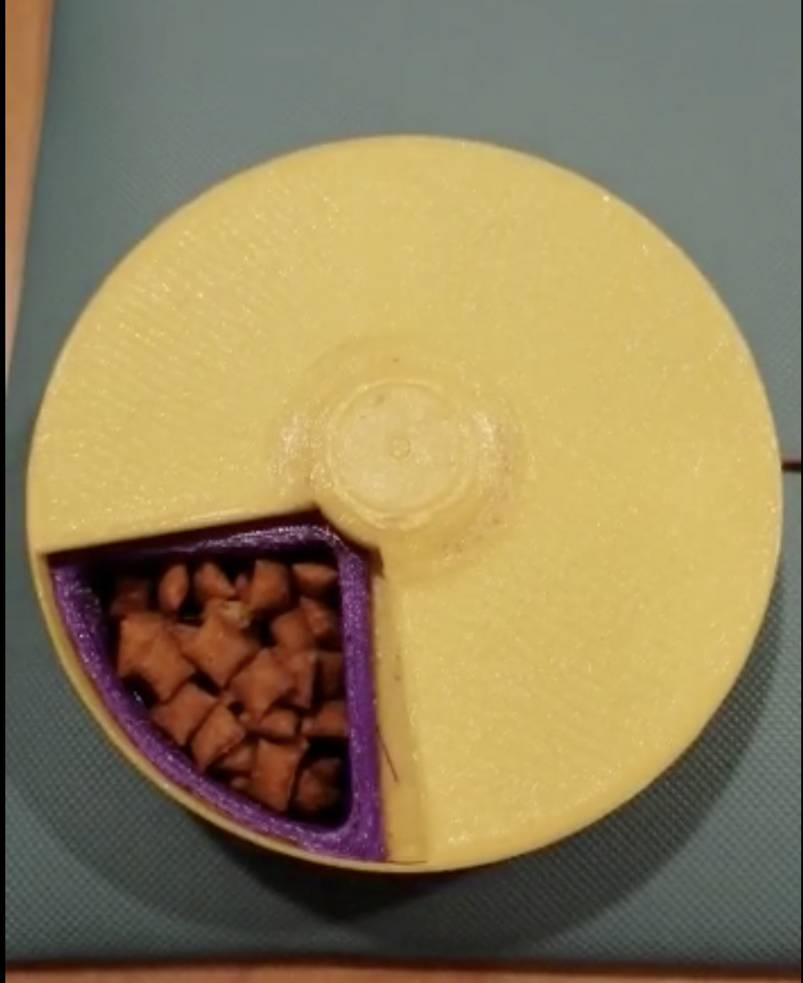
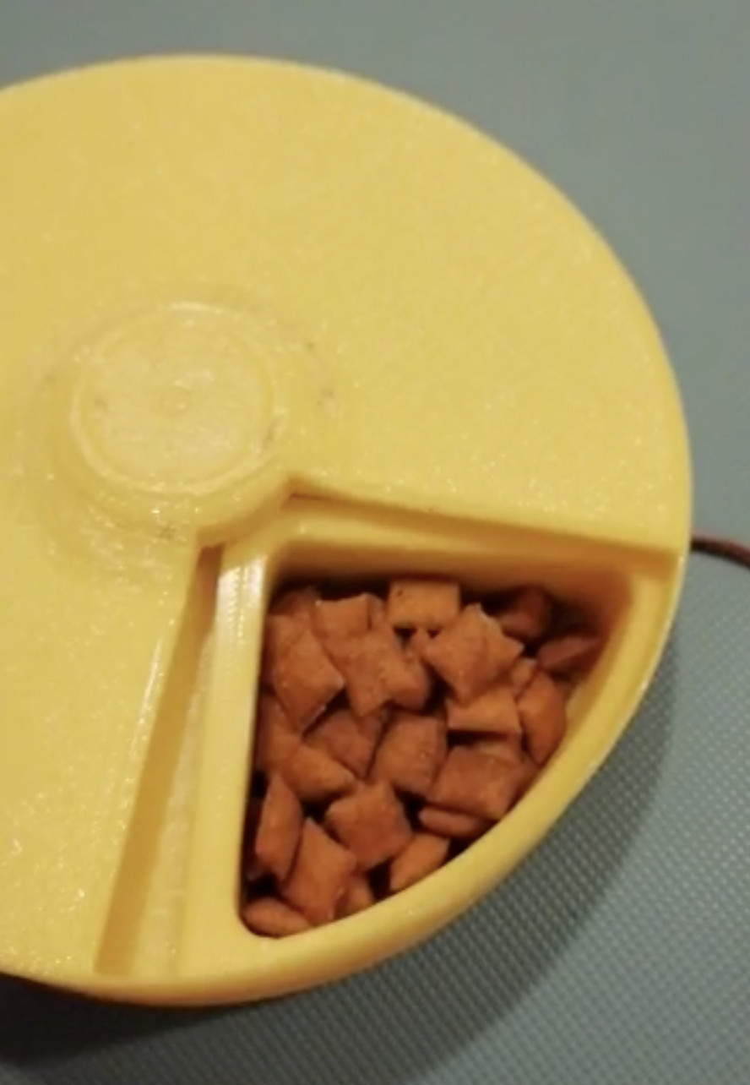
Project Topic
Pet Feeder Machine

Slide 4
Development Process
Development Tools
Raspberry Pi 0 - Pyhton
Android Studio - Java

Slide 5
Problems we faced
Weren’t have useful prototype design

Slide 6
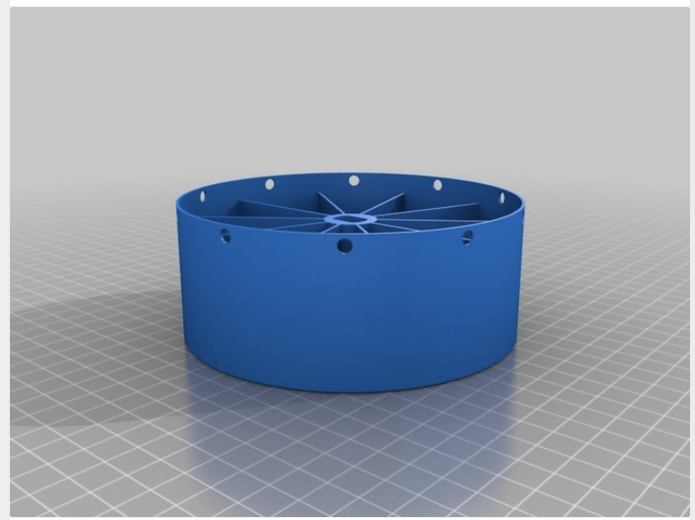
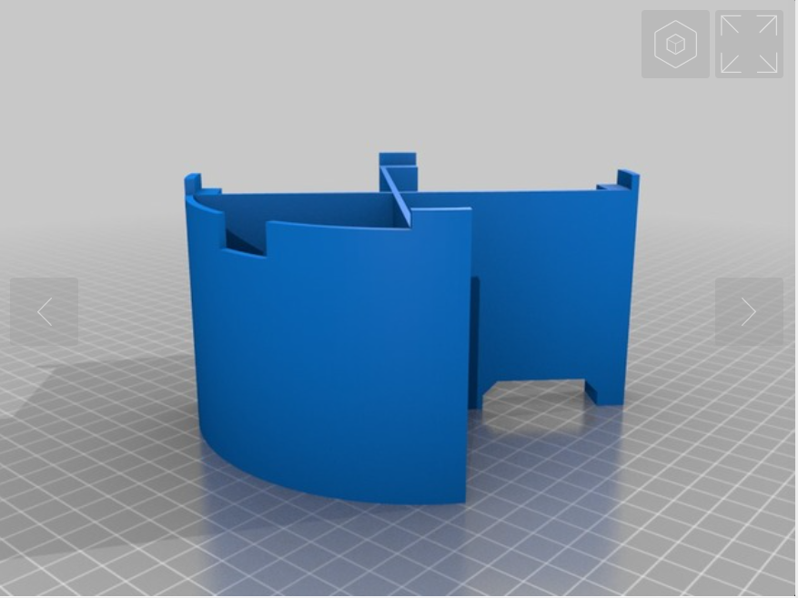
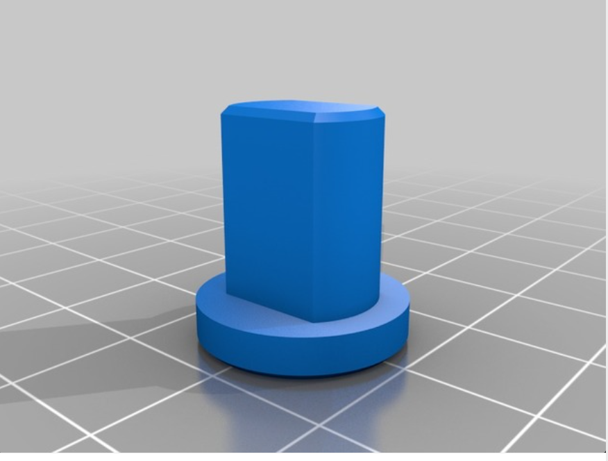
Problems we faced
Weren’t have useful prototype design
We searched different prototypes from https://www.thingiverse.com/

Slide 7
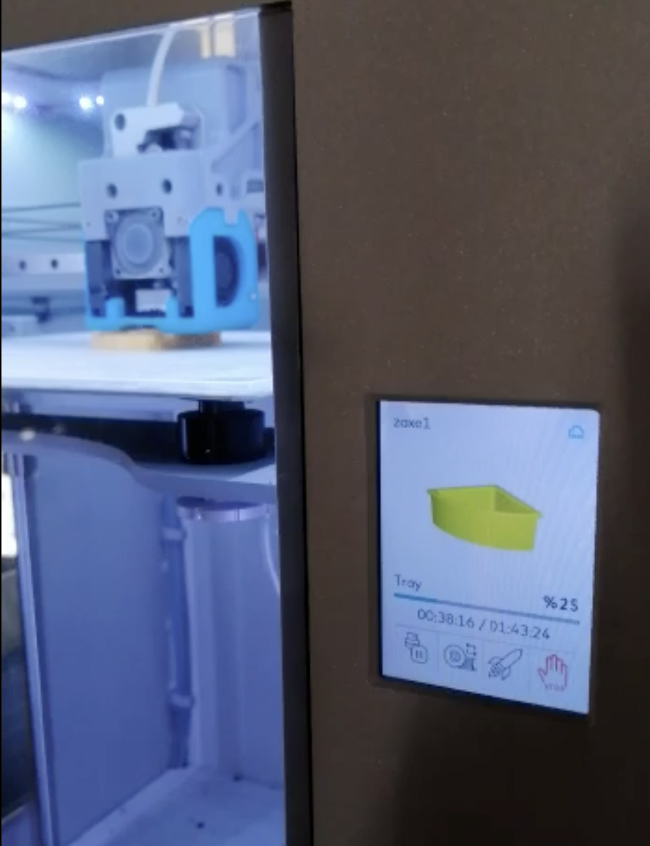
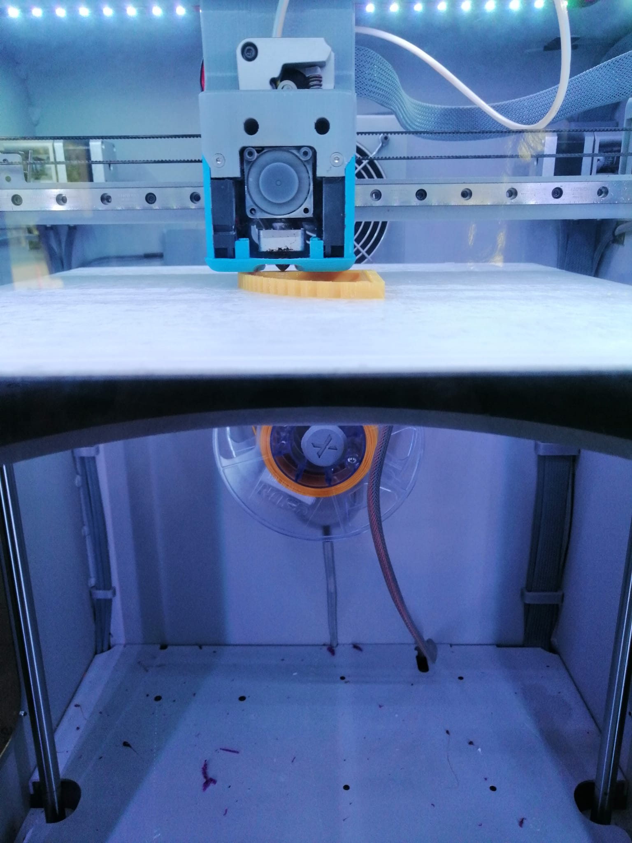
Problems we faced
Weren’t have useful prototype design
We printed a prototype like this by using 3D printer.

Slide 8
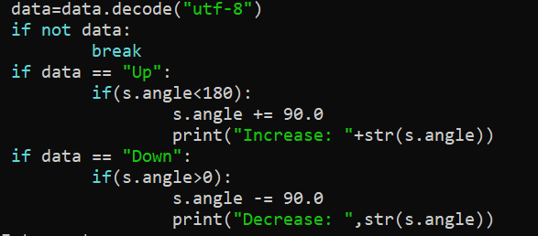
Problems we faced
Adjust the rotation angle
We used gpiozero library
By using gpiozero's angularservo method we easily adjust the rotation angle.

Slide 9
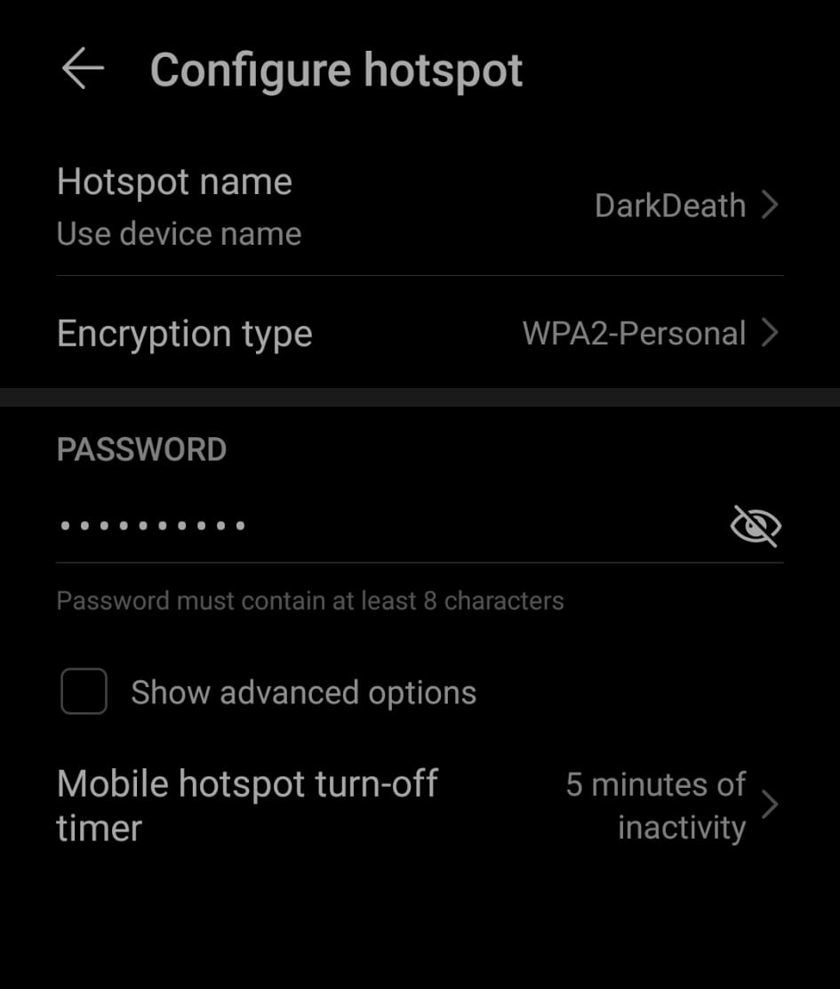
Problems we faced
Raspberry Connection
Hard to connect our computer to raspberry pi on the same network.
We solved this problem by setting the name and password of the hotspot wifi as the same as the Raspberry pi 0.

Slide 10
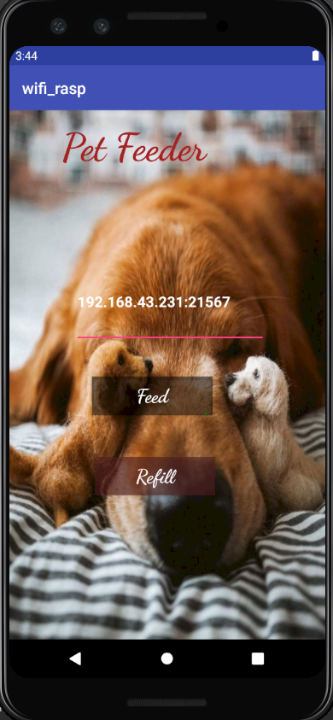
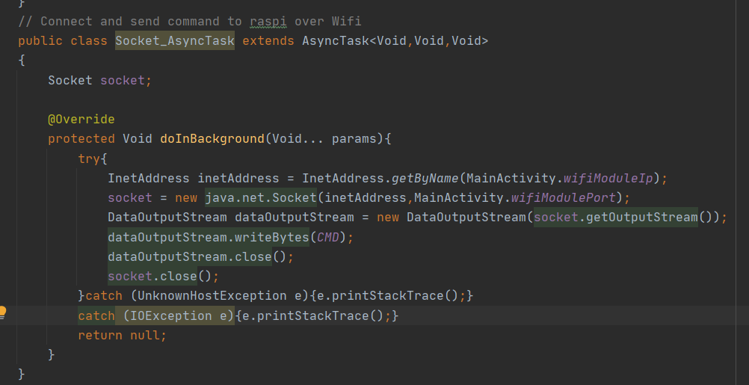
Problems we faced
Sending commands from mobile app
In order to send commands from mobile app to raspberry we needed to define the IP address of the internet to which raspberry is connected.

Slide 11
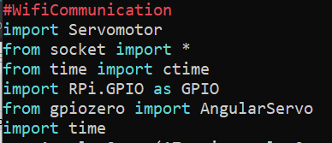
Libraries we used
RPi.GPIO
gpiozero
socket
time

Slide 12
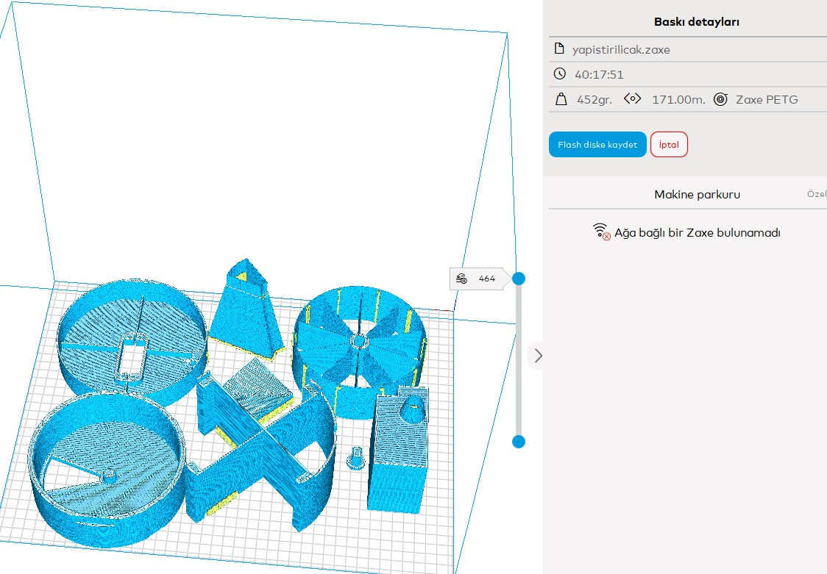
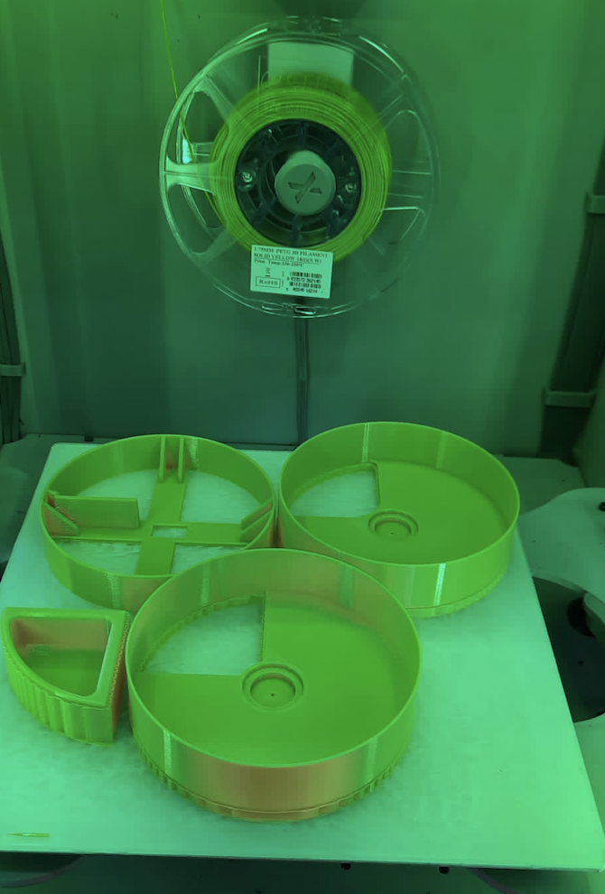
Technologies we learned
3D Printing
We print our 3D prototype using 3D printer and we learn how to do it.

Slide 13
Thanks for listening!

